Slide 1
Memory Management
CS422/522 Lecture 4
8 September 2014
Last updated: 8 September 2014
张义飞 2015

Slide 2
Outline
Recap
Page Table Performance / Overheads
Xv6 Code Walkthrough
Page Faults
Page Files
Wrap-Up
张义飞 2015

Slide 3
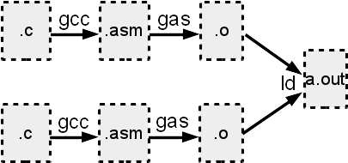
Recap
        Segmentation
        Page Tables
        Page Sharing
        Compiler, assembler, linking, loading
张义飞 2015

Slide 4
Outline
Recap
Page Table Performance / Overheads
Xv6 Code Walkthrough
Page Faults
Page Files
Wrap-Up
张义飞 2015

Slide 5
Page Table Overhead
Each memory action requires multilevel page walking.
How to speed up?
Cache virtual to physical addresses
张义飞 2015

Slide 6
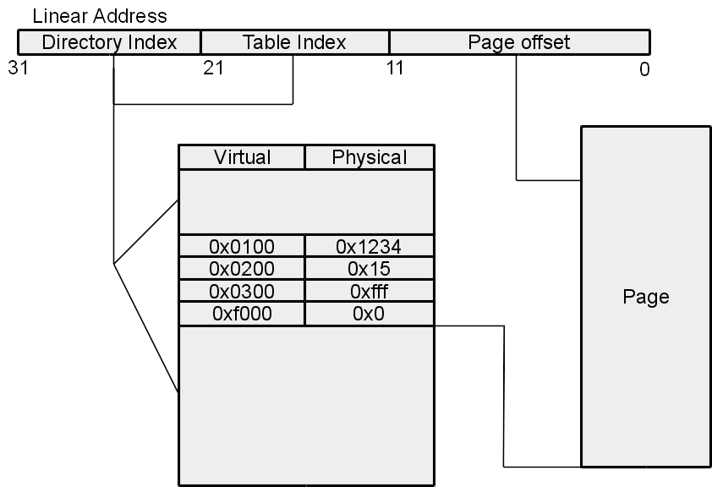
Translation Lookaside Buffer
Maps virtual to physical
x86 hardware managed
Any challenges?
  Page directory changes
  Deleting mapped pages
张义飞 2015

Slide 7
Limited Memory / Large Addresses
64-bit address space
4KB page
Potentially large page table!
2^12*2^10*2^10*2*10*2^10 bytes
张义飞 2015

Slide 8
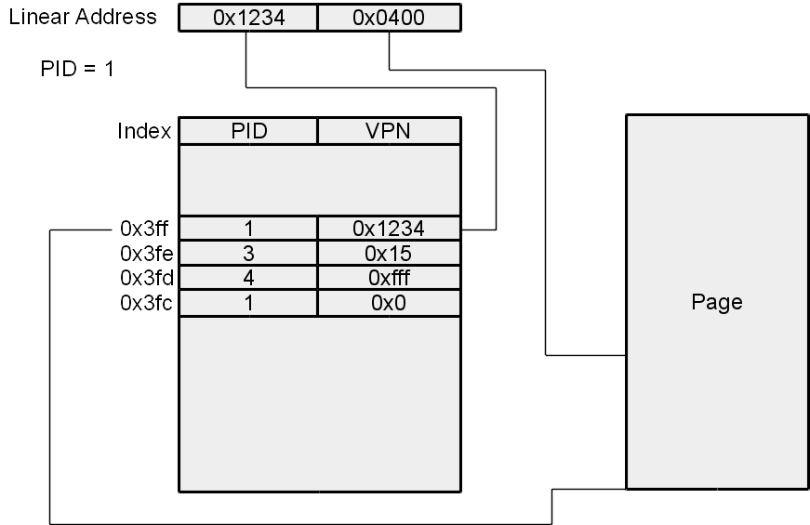
Inverted Page Tables
How to speed up?
Hash upper bits of linear address to fixed location
OS handles misses.
张义飞 2015

Slide 9
Inverted vs Normal
Inverted
  Fixed size
  Potentially more time for lookups
  Requires a means to handle page table faults
Normal
  OS can enforce a ratio of PT to physical memory
  Scales with memory
  Quicker look ups
  Sharing made easy
张义飞 2015

Slide 10
Outline
Recap
Page Table Performance / Overheads
Xv6 Code Walkthrough
Page Faults
Page Files
Wrap-Up
张义飞 2015

Slide 11
Last time
Loaded flat memory code and data descriptors
Entered 32-bit protected mode
Loaded kernel data into memory
Called kernel entry point
张义飞 2015

Slide 12
Code Overview
Start paging with a temporary allocation
Create real memory mapping in a new page table
Enter new page table
Enter new gdt with user and system descriptors
张义飞 2015

Slide 13
Bootstrapping
1032 # By convention, the _start symbol specifies the ELF entry point.
1033 # Since we haven’t set up virtual memory yet, our entry point is
1034 # the physical address of ’entry’.
1035 .globl _start
1036 _start = V2P_WO(entry)
1037
1038 # Entering xv6 on boot processor, with paging off.
1039 .globl entry
1040 entry:
张义飞 2015

Slide 14
Bootstrapping
The first thing a kernel does is turn on paging...
1041 # Turn on page size extension for 4Mbyte pages
1042 movl %cr4, %eax
1043 orl $(CR4_PSE), %eax
1044 movl %eax, %cr4
1045 # Set page directory
1046 movl $(V2P_WO(entrypgdir)), %eax
1047 movl %eax, %cr3
1048 # Turn on paging.
1049 movl %cr0, %eax
1050 orl $(CR0_PG|CR0_WP), %eax
1051 movl %eax, %cr0
张义飞 2015

Slide 15
Bootstrapping
1270 pde_t entrypgdir[]; // For entry.S
...
1306 // Boot page table used in entry.S and entryother.S.
1307 // Page directories (and page tables), must start on a page boundary,
1308 // hence the "__aligned__" attribute.
1309 // Use PTE_PS in page directory entry to enable 4Mbyte pages.
1310 __attribute__((__aligned__(PGSIZE)))
1311 pde_t entrypgdir[NPDENTRIES] = {
1312 // Map VA’s [0, 4MB) to PA’s [0, 4MB)
1313 [0] = (0) | PTE_P | PTE_W | PTE_PS,
1314 // Map VA’s [KERNBASE, KERNBASE+4MB) to PA’s [0, 4MB)
1315 [KERNBASE>>PDXSHIFT] = (0) | PTE_P | PTE_W | PTE_PS,
1316 };
张义飞 2015

Slide 16
Bootstrapping
1053 # Set up the stack pointer.
1054 movl $(stack + KSTACKSIZE), %esp
1055
1056 # Jump to main(), and switch to executing at
1057 # high addresses. The indirect call is needed because
1058 # the assembler produces a PC−relative instruction
1059 # for a direct jump.
1060 mov $main, %eax
1061 jmp *%eax
1062
1063 .comm stack, KSTACKSIZE
张义飞 2015

Slide 17
Setting up Virtual Memory
1211 extern char end[]; // first address after kernel loaded from ELF file
...
1216 int
1217 main(void)
1218 {
1219 kinit1(end, P2V(4*1024*1024)); // phys page allocator
1220 kvmalloc(); // kernel page table
...
1223 seginit(); // set up segments
...
1238 kinit2(P2V(4*1024*1024), P2V(PHYSTOP)); // must come after startothers()
...
张义飞 2015

Slide 18
Setting up Virtual Memory
2774 // Initialization happens in two phases.
2775 // 1. main() calls kinit1() while still using entrypgdir to place just
2776 // the pages mapped by entrypgdir on free list.
2777 // 2. main() calls kinit2() with the rest of the physical pages
2778 // after installing a full page table that maps them on all cores.
2779 void
2780 kinit1(void *vstart, void *vend)
2781 {
2782 initlock(&kmem.lock, "kmem");
2783 kmem.use_lock = 0;
2784 freerange(vstart, vend);
2785 }
张义飞 2015

Slide 19
Setting up Virtual Memory
2800 void
2801 freerange(void *vstart, void *vend)
2802 {
2803 char *p;
2804 p = (char*)PGROUNDUP((uint)vstart);
2805 for(; p + PGSIZE <= (char*)vend; p += PGSIZE)
2806 kfree(p);
2807 }
张义飞 2015

Slide 20
Setting up Virtual Memory
2810 // Free the page of physical memory pointed at by v,
2811 // which normally should have been returned by a
2812 // call to kalloc(). (The exception is when
2813 // initializing the allocator; see kinit above.)
2814 void
2815 kfree(char *v)
2816 {
2817 struct run *r;
2819 if((uint)v % PGSIZE || v < end || v2p(v) >= PHYSTOP)
2820 panic("kfree");
...
2827 r = (struct run*)v;
2828 r−>next = kmem.freelist;
2829 kmem.freelist = r;
...
2832 }
张义飞 2015

Slide 21
Setting up Virtual Memory
2827 r = (struct run*)v;
2828 r−>next = kmem.freelist;
...
2764 struct run {
2765 struct run *next;
2766 };
张义飞 2015

Slide 22
Setting up Virtual Memory
1754 // Allocate one page table for the machine for the kernel address
1755 // space for scheduler processes.
1756 void
1757 kvmalloc(void)
1758 {
1759 kpgdir = setupkvm();
1760 switchkvm();
1761 }
张义飞 2015

Slide 23
Setting up Virtual Memory
1754 // Allocate one page table for the machine for the kernel address
1755 // space for scheduler processes.
1756 void
1757 kvmalloc(void)
1758 {
1759 kpgdir = setupkvm();
1760 switchkvm();
1761 }
张义飞 2015

Slide 24
Setting up Virtual Memory
2834 // Allocate one 4096−byte page of physical memory.
2835 // Returns a pointer that the kernel can use.
2836 // Returns 0 if the memory cannot be allocated.
2837 char*
2838 kalloc(void)
2839 {
2840 struct run *r;
...
2844 r = kmem.freelist;
2845 if(r)
2846 kmem.freelist = r−>next;
...
2849 return (char*)r;
2850 }
张义飞 2015

Slide 25
Setting up Virtual Memory
1736 pde_t*
1737 setupkvm(void)
...
1744 memset(pgdir, 0, PGSIZE);
1745 if (p2v(PHYSTOP) > (void*)DEVSPACE)
1746 panic("PHYSTOP too high");
1747 for(k = kmap; k < &kmap[NELEM(kmap)]; k++)
1748 if(mappages(pgdir, k−>virt,
k−>phys_end − k−>phys_start,
1749 (uint)k−>phys_start, k−>perm) < 0)
1750 return 0;
1751 return pgdir;
1752 }
张义飞 2015

Slide 26
Setting up Virtual Memory
1723 static struct kmap {
1724 void *virt;
1725 uint phys_start;
1726 uint phys_end;
1727 int perm;
1728 } kmap[] = {
1729 { (void*)KERNBASE, 0, EXTMEM, PTE_W}, // I/O space
1730 { (void*)KERNLINK, V2P(KERNLINK), V2P(data), 0}, // kern text+rodata
1731 { (void*)data, V2P(data), PHYSTOP, PTE_W}, // kern data+memory
1732 { (void*)DEVSPACE, DEVSPACE, 0, PTE_W}, // more devices
1733 };
张义飞 2015

Slide 27
Setting up Virtual Memory
1675 // Create PTEs for virtual addresses starting at va that refer to
1676 // physical addresses starting at pa. va and size might not
1677 // be page−aligned.
1678 static int
1679 mappages(pde_t *pgdir, void *va, uint size,
uint pa, int perm)
1680 {
1681 char *a, *last;
1682 pte_t *pte;
1683
1684 a = (char*)PGROUNDDOWN((uint)va);
1685 last = (char*)PGROUNDDOWN(((uint)va) + size − 1);
1686 for(;;){
1687 if((pte = walkpgdir(pgdir, a, 1)) == 0)
1688 return −1;
...
张义飞 2015

Slide 28
Setting up Virtual Memory
1650 // Return the address of the PTE in page table pgdir
1651 // that corresponds to virtual address va. If alloc!=0,
1652 // create any required page table pages.
1653 static pte_t *
1654 walkpgdir(pde_t *pgdir, const void *va, int alloc)
1655 {
1656 pde_t *pde;
1657 pte_t *pgtab;
1659 pde = &pgdir[PDX(va)];
1660 if(*pde & PTE_P){
1661 pgtab = (pte_t*)p2v(PTE_ADDR(*pde));
1662 } else {
1663 if(!alloc || (pgtab = (pte_t*)kalloc()) == 0)
1664 return 0;
1666 memset(pgtab, 0, PGSIZE);
1670 *pde = v2p(pgtab) | PTE_P | PTE_W | PTE_U;
1671 }
1672 return &pgtab[PTX(va)];
1673 }
张义飞 2015

Slide 29
Setting up Virtual Memory
1678 static int
1679 mappages(pde_t *pgdir, void *va, uint size,
uint pa, int perm)
...
1689 if(*pte & PTE_P)
1690 panic("remap");
1691 *pte = pa | perm | PTE_P;
1692 if(a == last)
1693 break;
1694 a += PGSIZE;
1695 pa += PGSIZE;
1696 }
1697 return 0;
1698 }
张义飞 2015

Slide 30
Setting up Virtual Memory
1763 // Switch h/w page table register to the kernel−only page table,
1764 // for when no process is running.
1765 void
1766 switchkvm(void)
1767 {
1768 lcr3(v2p(kpgdir)); // switch to the kernel page table
1769 }
张义飞 2015

Slide 31
Setting up Virtual Memory
1613 // Set up CPU’s kernel segment descriptors.
1614 // Run once on entry on each CPU.
1615 void
1616 seginit(void)
1617 {
1618 struct cpu *c;
...
1624 c = &cpus[cpunum()];
1625 c−>gdt[SEG_KCODE] = SEG(STA_X|STA_R, 0, 0xffffffff, 0);
1626 c−>gdt[SEG_KDATA] = SEG(STA_W, 0, 0xffffffff, 0);
1627 c−>gdt[SEG_UCODE] = SEG(STA_X|STA_R, 0, 0xffffffff, DPL_USER);
1628 c−>gdt[SEG_UDATA] = SEG(STA_W, 0, 0xffffffff, DPL_USER);
...
1633 lgdt(c−>gdt, sizeof(c−>gdt));
...
1639 }
张义飞 2015

Slide 32
Setting up Virtual Memory
2787 void
2788 kinit2(void *vstart, void *vend)
2789 {
2790 freerange(vstart, vend);
2791 kmem.use_lock = 1;
2792 }
张义飞 2015

Slide 33
Wrap up
Used a temporary page of 4 MB
Last portion was used to construct new page table
Entered new page table
Entered new gdt with user and system descriptors
Mapped the kernel page tables
张义飞 2015

Slide 34
Outline
Recap
Page Table Performance / Overheads
Xv6 Code Walkthrough
Page Faults
Page Files
Wrap-Up
张义飞 2015

Slide 35
Exceptions (Briefly)
What are they? Something unexpected happen, force a call itno a special table
What type of memory accesses would be exceptional?
  Page / segment defined but not present
(Page Fault / Segment Not Present)
  Attempt to access paged memory of a higher privilege
(Page Fault)
  Stack segment limit or presence violation
(Stack Exception)
  Access invalid memory
(General Protection Exception)
张义飞 2015

Slide 36
Page Faults in Xv6
Allocate memory at load (xv6/exec.c line 5934)
There are no expected page faults
张义飞 2015

Slide 37
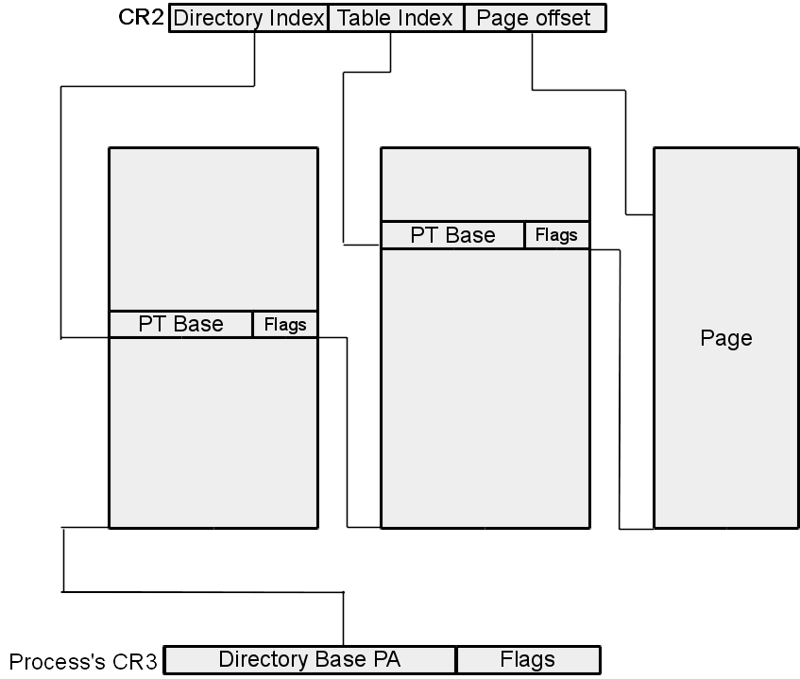
Page Faults
Valid but P not set in PTE
OS receives an exception
Passes to memory manager
Memory manager:
  Allocates pages
  Retrieves data from disk
  Stores data to the pages
  Maps pages to processes' virtual memory
OS returns execution back to fault causing instruction
张义飞 2015

Slide 38
Reasons for Page Faults
Guard pages (page stack out of space)
Copy on write
Pages swapped to disk (over allocation)
Data never loaded (on demand)
张义飞 2015

Slide 39
Outline
Recap
Page Table Performance / Overheads
Xv6 Code Walkthrough
Page Faults
Page Files
Wrap-Up
张义飞 2015

Slide 40
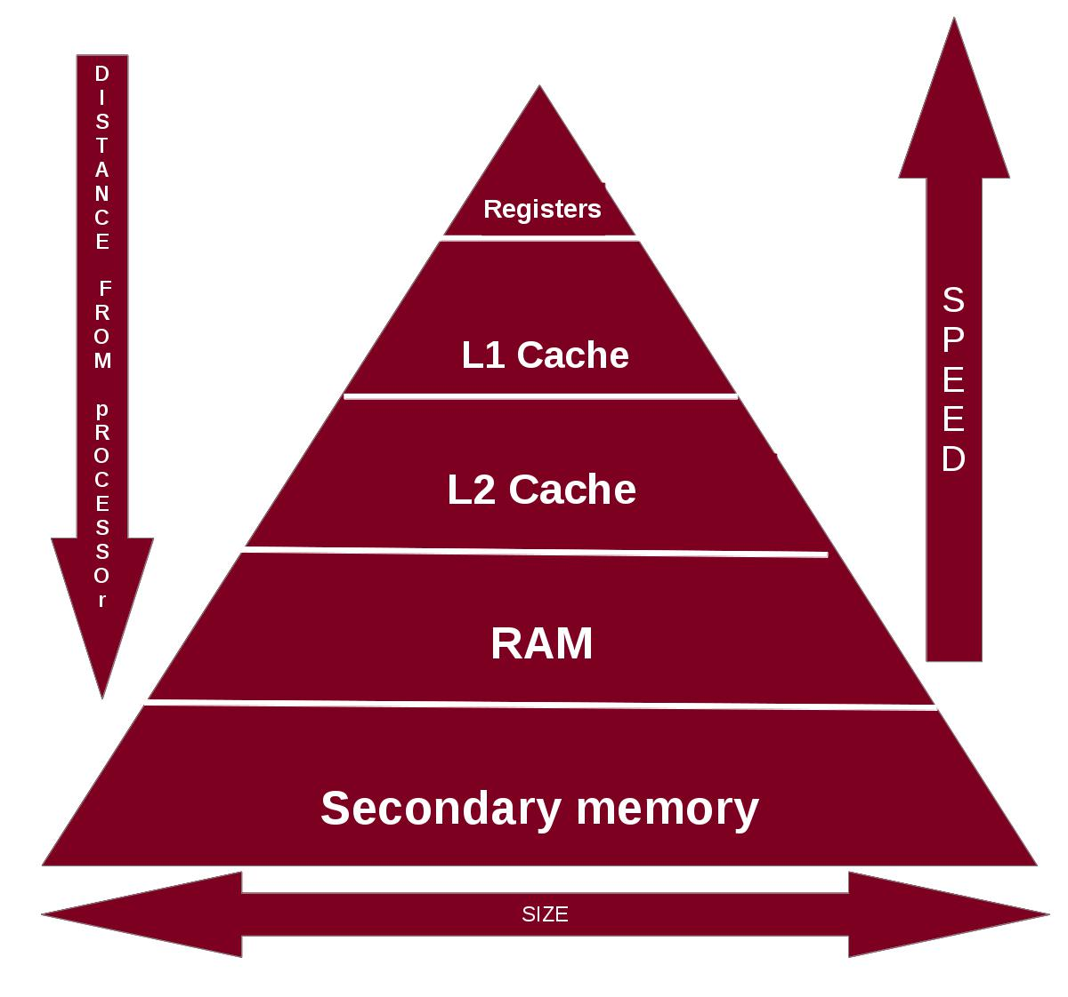
Memory Hierarchy
RAM / registers limited in size
Over-allocate and store some on disk!
张义飞 2015

Slide 41
First in, First out
Use oldest page
OS data structures? "Stack" of pages
Issue(s): Ignores use of page
张义飞 2015

Slide 42
Second Chance
Enhanced FIFO
Check accessed bit:
  If unset, use page
  Else unset, test next oldest page
Can also use write bits
张义飞 2015

Slide 43
Least Recently Used
Find page of oldest unaccessed memory
Building into OS:
  Must check access bit -- frequency?
  Stack based:
    If accessed, push to top
    If need page, pop from bottom
  Timestamp:
    Add a timestamp field
    Find smallest and use
张义飞 2015

Slide 44
Modern Issues
Garbage collection and streaming media invalidate LRU.
  Not recently used -- LRU approximation
  Used-once -- LRU / FIFO
    New pages start on inactive list
    Promoted to active list after multiple use
    Pages reclaimed at the end of inactive list
    Occassionally garbage collect active list
张义飞 2015

Slide 45
Outline
Recap
Page Table Performance / Overheads
Xv6 Code Walkthrough
Page Faults
Page Files
Wrap-Up
张义飞 2015

Slide 46
Systems Seminar
Tomorrow's Topic: Tor
Tuesdays at 11:45AM
AKW307
Pizza
Please contact me if you intend to come
张义飞 2015

Slide 47
Next Time
Wednesday 1:00PM
Traps, Interrupts, and the System Call Interface
张义飞 2015

